Slide 1
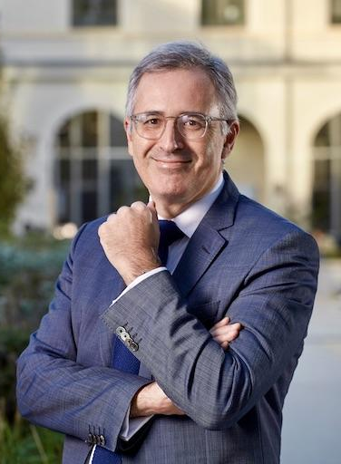
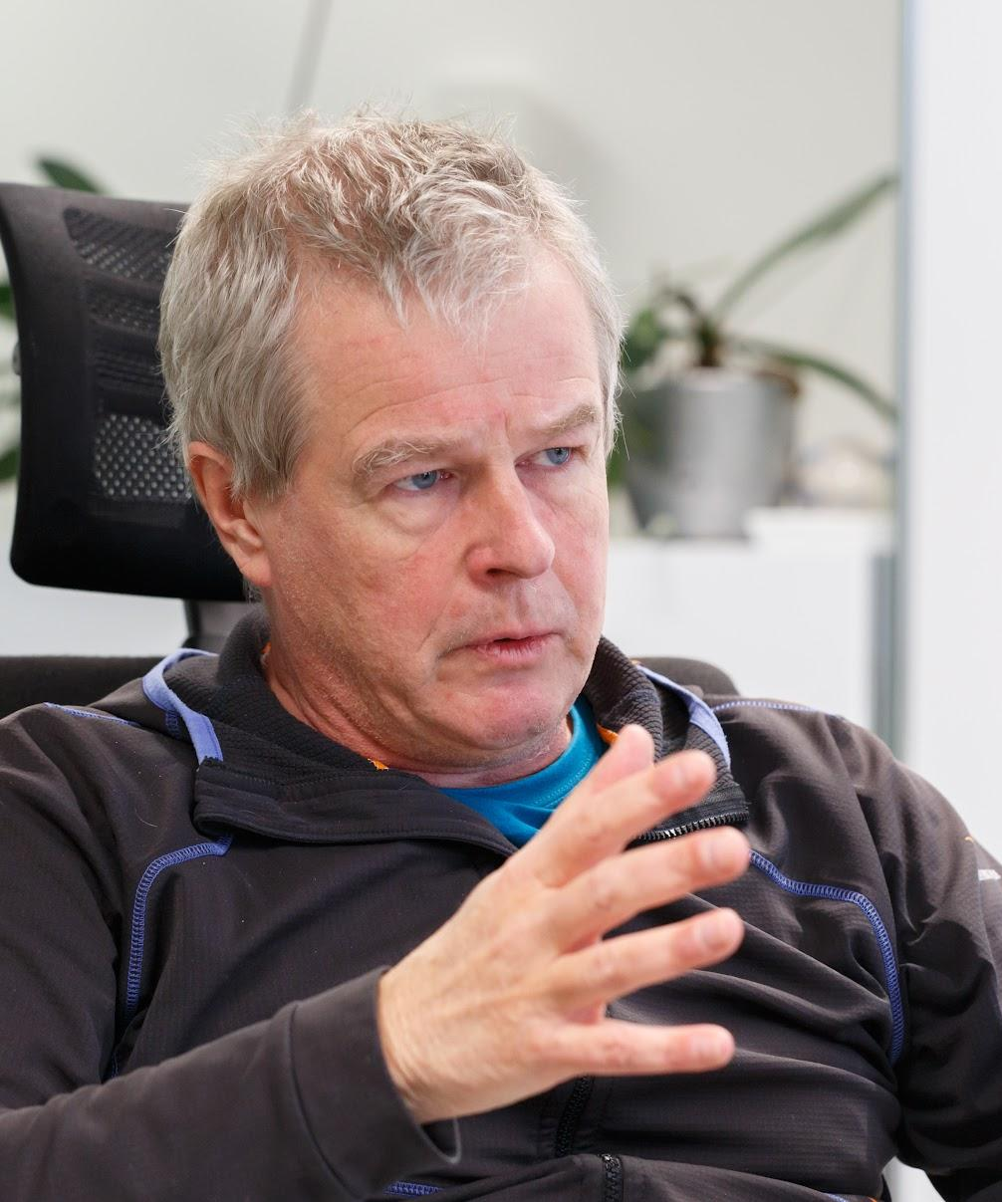
CALL FOR PAPERS
ACDD 21st Edition
Strasbourg – 21st and 22nd May 2024
The Augustin Cournot Doctoral Days (ACDD) conference is an international event dedicated to the promotion of excellence in doctoral research. The conference aims to offer Ph.D. candidates an academic environment to present their latest work, discuss with senior researchers and share ideas with other international colleagues in the cosmopolitan European capital of Strasbourg.
Submission deadline
We invite you to submit preliminary papers to https://acdd.sciencesconf.org/ until March 15th, 2024. Selected papers will be notified by April 12th, 2024.
Topics of interest
Papers are accepted in the following fields : Economics, Finance, Management, Environment, Innovation science & Technology studies, Epistemology, History of economic thought.
Keynote Speakers
Sergei GURIEV
Steven ONGENA
Professor of Economics,
Political Economics,
Sciences Po Paris
Professor of Finance,
Banking,
University of Zurich / Swiss Finance Institute

Slide 2
Conference information
The ACDD include parallel and plenary sessions. Accepted papers will be presented in parallel sessions. Each presentation is limited to 20 minutes, followed by a 10-minute discussion with a senior discussant. Plenary sessions are scheduled during the two days with participation from invited keynote speakers.
Awards for best papers
Two "ACDD Best Paper Awards" will be granted during the ceremony at the Strasbourg’s historical city hall on the final evening. The prize selection will be entrusted to members of the scientific advisory committee. We will consider only complete papers that are submitted within the deadline and that have not been published in any academic journal. Please note that nominees must be currently enrolled as Ph.D. students.
Fees
The registration fee is 110 euros. This sum covers participation, all-day refreshments, lunches, cocktails, the gala dinner and other activities.
We look forward to seeing you in Strasbourg !
The steering committee :
Alexandre Prachant (BETA)
Axelle Heyert (LaRGE)
Mathilde Clerc (BETA)
Vincent Zanello (BETA)
Lucas Jeanneau (BETA)
Tra Tran Thien (BETA)
For any further information, please refer to:
E-mail : acddconference@gmail.com
Website : https://acdd.sciencesconf.org/
Twitter : @acddconference
LinkedIn : https://www.linkedin.com/in/augustin-cournot-doctoral-days-6a944b117
Facebook : facebook.com/acddconference
https://acdd.sciencesconf.org/

